Slide 1
Credit Risk Prediction
Final Project Hacktiv8
A Machine Learning Classification
Alsello D. Manuputty
FTDS HCK-006 Pondok Indah

Slide 2
Outline
Intro
EDA
Model
Conclusion
Objective & Data Introduction
Data Visualisation
Prediction Results
Improvement Ideas
Business Insights

Slide 3
Objective
Intro
Credit Risk Prediction with Machine Learning model from historical data

Slide 4
Advantages
Intro
Reduce inconvenience
Flexibility
More predictions
Risk Assessment
Power
Customer personalisation
Service
Fraud Protection
Security

Slide 5
Disadvantages
Intro
Dismissal
Decreasing work performance
Bias Concerns
Integration
Unfair discriminatory lending decision
Modify existing legacy systems

Slide 6
Data Introduction
EDA
73 Columns 887,379 Rows
ID, Member ID, Title
Income, Loan, Employment, Credit History, Assets
Public Record, Spending Pattern, Payment Records
Loan Status
Personal
Financial
Behavioral
Target

Slide 7
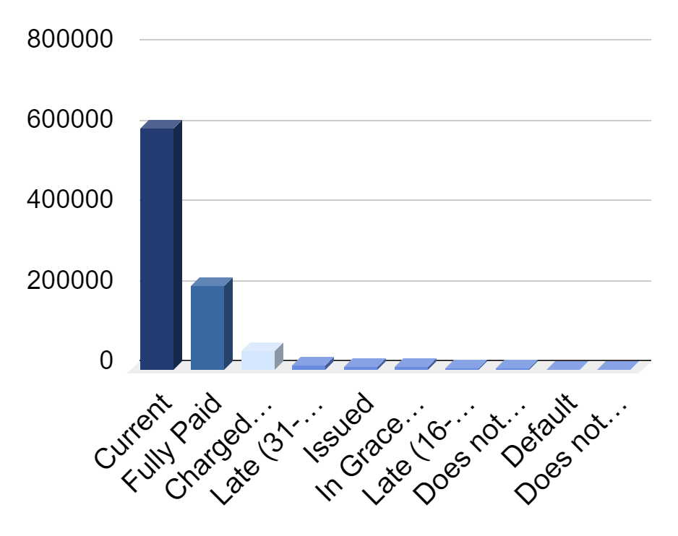
Loan Status
EDA
Kategori 0
0
Issued, Current, Fully Paid, Does not meet the credit policy. Status:Fully Paid
Kategori 1
1
In Grace Period, Late (16-30 days), Late (31-120 days)
Kategori 2
2
Charged Off , Does not meet the credit policy. Status:Charged Off, Default

Slide 8
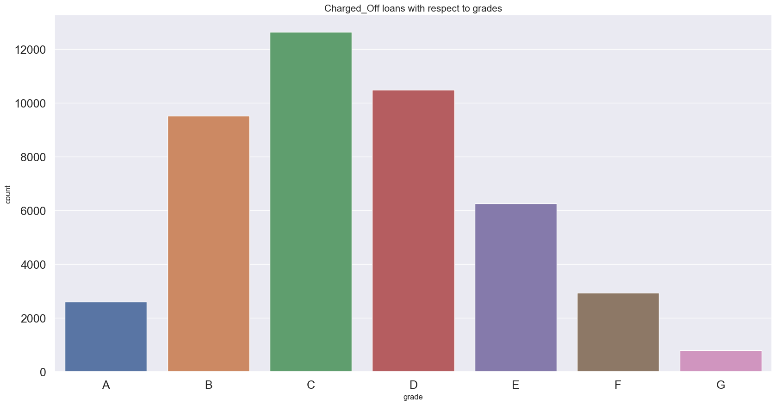
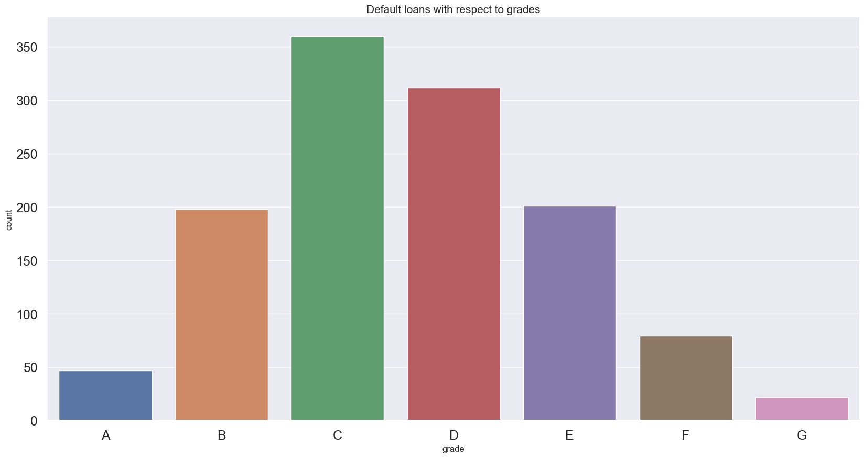
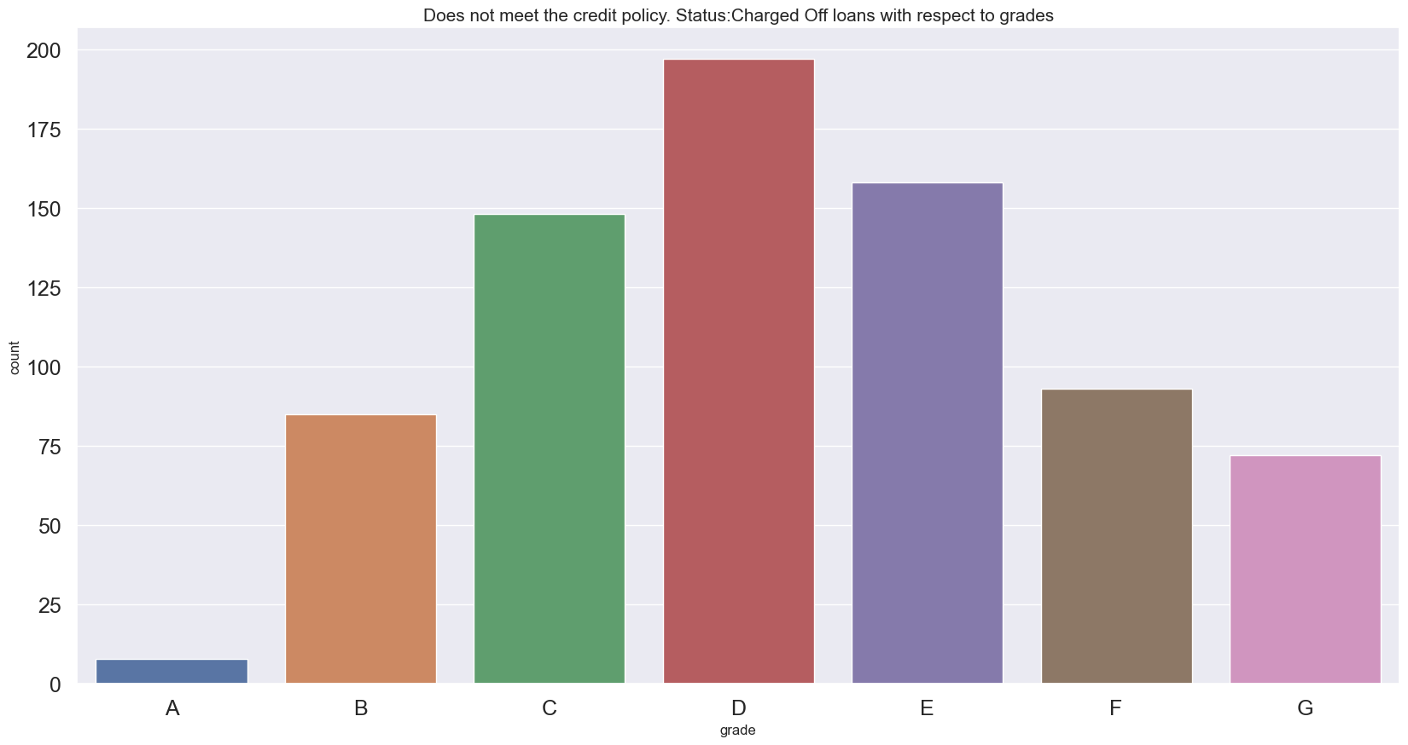
Cat 2 Loan Status
EDA

Slide 9
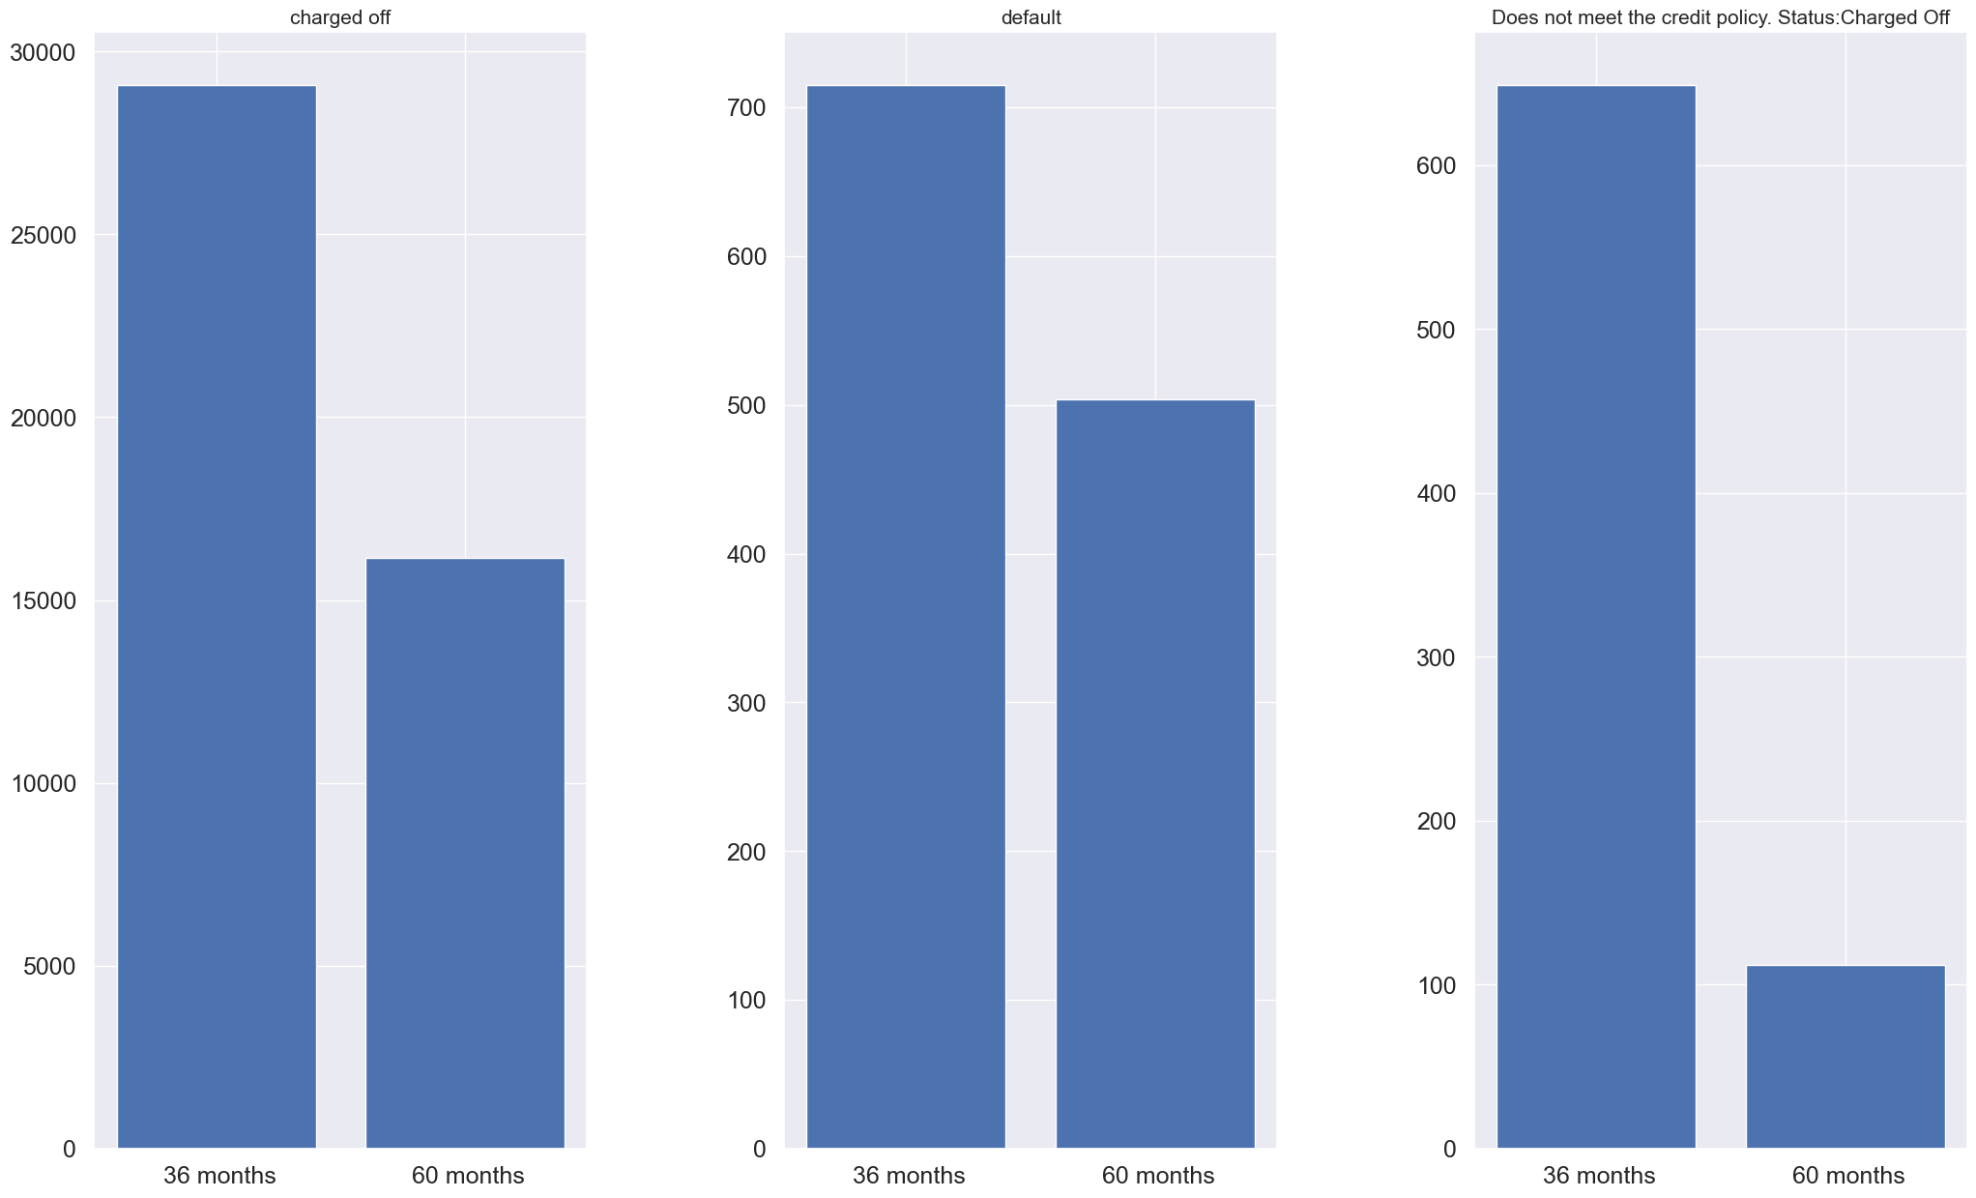
Relationship with Terms
EDA

Slide 10
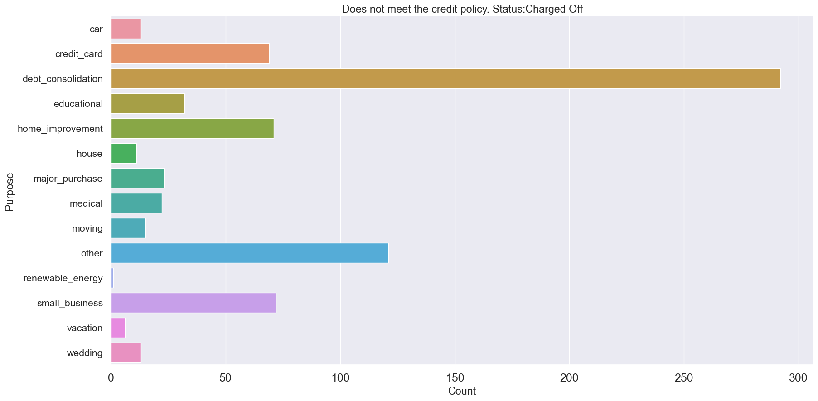
Relationship with Purpose
EDA

Slide 11
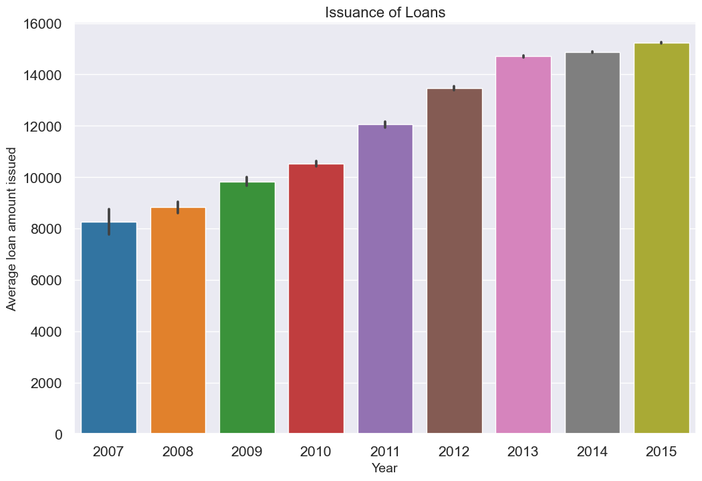
Issuance Growth over the years
EDA

Slide 12
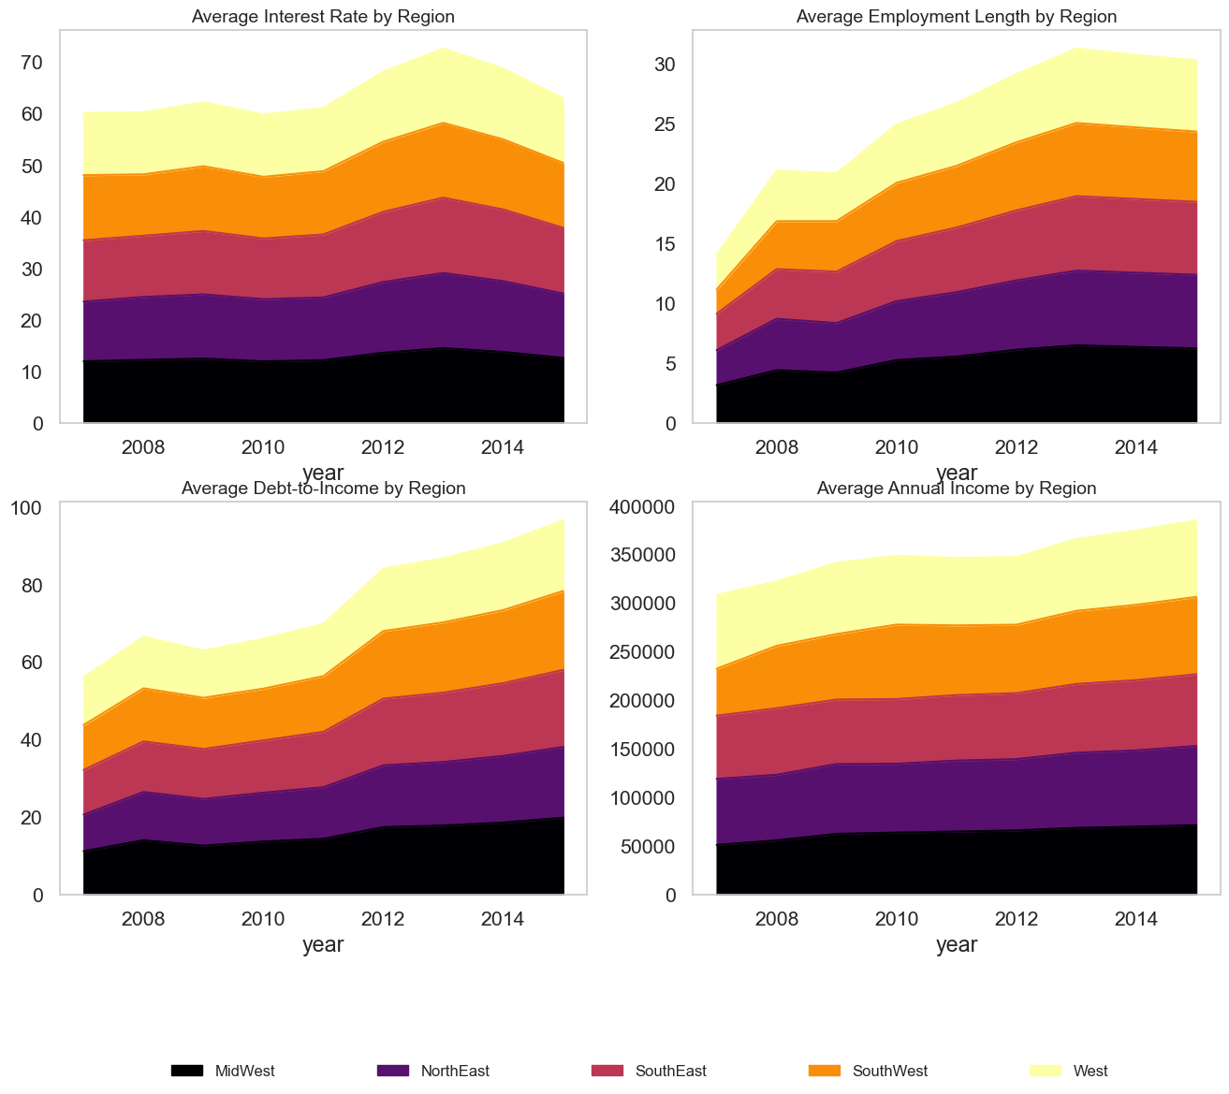
Yearly Data per Region
EDA

Slide 13
Model
Workflow
Data Loading
EDA
Feature Engineering
Model Definition
Model Evaluation
Conclusion

Slide 14
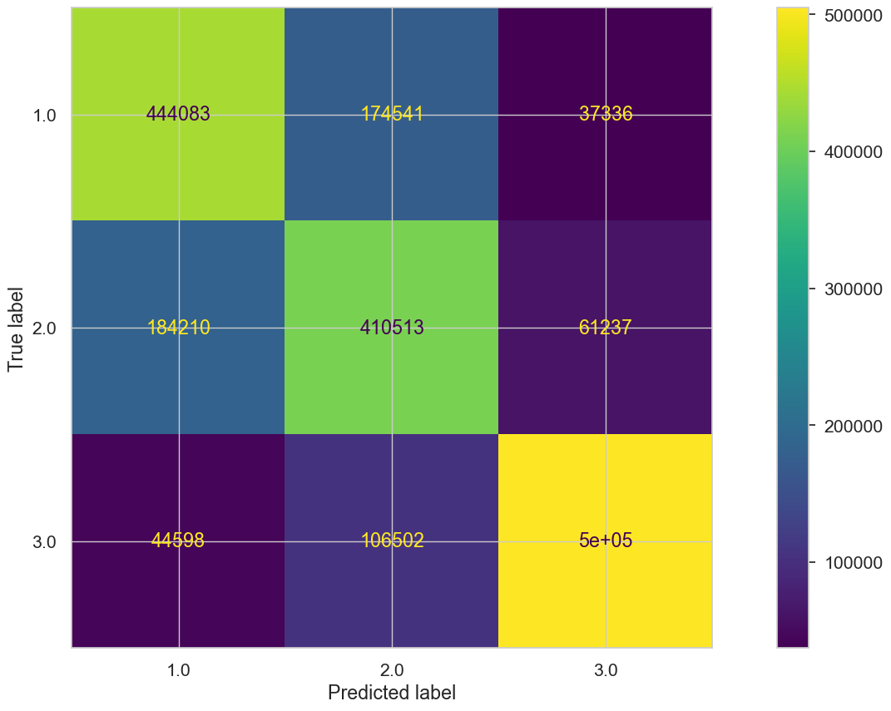
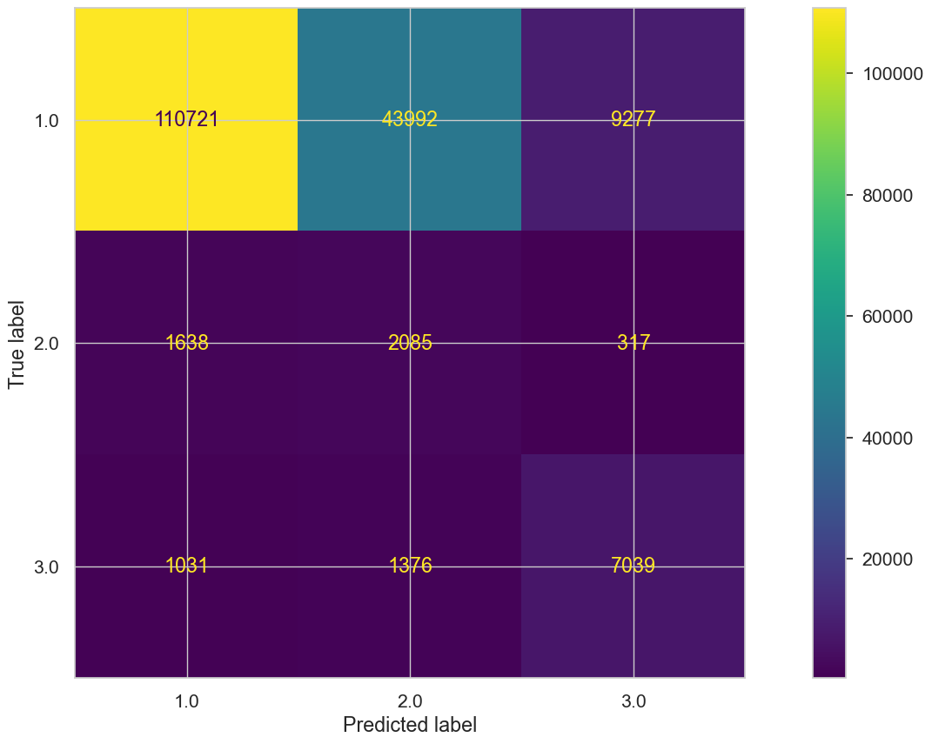
Model
TestClass | Count
0 | 163990
1 | 4040
2 | 9446
Metrics | Cat 0 | Cat 1 | Cat 2
Train Recall | 0.68 | 0.63 | 0.77
Test Recall | 0.68 | 0.52 | 0.75

Slide 15
Conclusions
Model & Data
Business Insights
1
Behavioral Analysis
Develop Data Driven Policies
1
2
Early Warning
Churn Prediction
Optimize Marketing efforts
2
3
Improvements
Enhance Customer Experiences
3

Slide 16
Thank You!

